Slide 1
Getting to
Know DFPS
in 2026
Marshall Davidson
and
Kimberly Pendleton
Notes:
Updated April 2022

Slide 2

DFPS
CPI Statewide APS CPS
Intake
Investigations Special Alternative
Investigations Response Conservatorship Family Based Safety Services
Trafficking
Child Care Investigations Single Source
Continuum Contractors Texas Family First
T3C
What you really need to know:
CPI, CPS, SSCC (or CBC), Conservatorship (CVS), Alternative Response (AR), and Investigation
Bonus: I and R

Slide 3
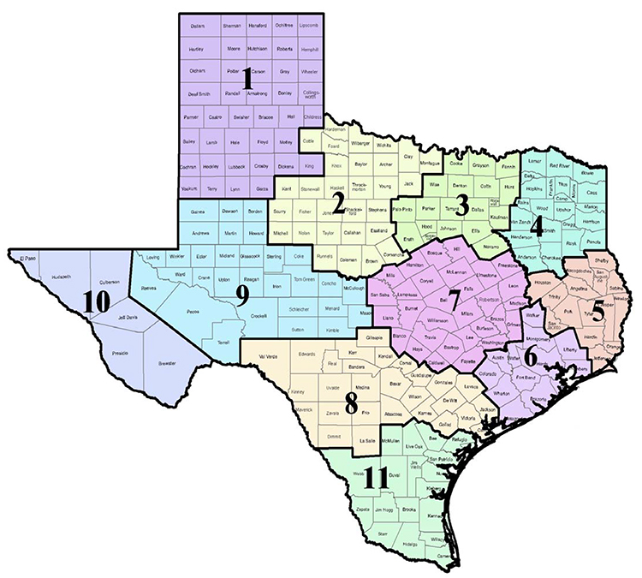
DFPS Regional Map

Slide 4
Word Salad
Why DFPS Acronyms and Phrases Matter
Child Protective Services (CPS)- Non investigative- provides services to youth and families in high risk situations, or after a child has been placed in the conservatorship of DFPS.
Child Protective Investigations (CPI)-Investigative division within DFPS. Investigations (including Alternative Response) can close with no further involvement by the Department, or may refer a family and child to CPS.
Single Source Continuum Contractor (SSCC) or Community Based Care (CBC)—
These are private entities working in conjunction with DFPS to provide ongoing services to youth and families. Not all areas of the State currently have a CBC contractor.

Slide 5
Ways to report abuse/neglect
STATEWIDE ABUSE HOTLINE
1-800-252-5400
TO REPORT ONLINE
WWW.DFPS.TEXAS.GOV
USE HOTLINE NUMBER IF IMMEDIATE SAFETY IS A CONCERN
Notes:
Discuss if immediate response is needed that it is better to call as it gets to us faster. Online reporting is better to use when incident has already occurred and children are safe

Slide 6
Who must report?
Any person who suspects that a child has been
abused or neglected by any person must report the suspected abuse or neglect
Notes:
Highlight the word suspects –they don’t need to do their own investigation. Also any person-no one is immune in the state of Texas for not reporting. I also talk about that the person with first hand knowledge repprts and that a person can not delegate their responsibility. Lastly must report-professionals have 48 hours but we ask that reports be made immediately

Slide 7
Legal Matters
*Reports of child abuse or neglect made in "good faith" and "without malice" are deemed confidential with protections under Texas Family Code.
*The law provides for immunity from civil or criminal liability for persons who report even unfounded suspicions, as long as the report is made in good faith.
*Professional reporters are required to report within 48 hours of first suspecting abuse or neglect
*Failure to report suspected abuse or neglect is a Class A Misdemeanor, punishable by imprisonment of up to one year and/or a fine up to $4,000.

Slide 8
Statutory Definition of Person Responsible for
Child's Care, Custody, or Welfare
"Person responsible for a child's care, custody, or welfare" means a person who traditionally is responsible for a child's care, custody, or welfare, including:
(A) a parent, guardian, managing or possessory conservator, or foster parent of the child;
(B) a member of the child's family or household
(C) a person with whom the child's parent cohabits;
(D) school personnel or volunteers at the child's school; or
(E) personnel or a volunteers at a public or private child-care facility that provides services for the child or at a public or private residential institution or facility where the child resides.

Slide 9
Investigations
Investigation Priority
Statewide Intake assigns reports or “intakes” for Investigations, which meet the statutory definitions of abuse and neglect with an assigned priority based on the alleged severity of harm and level of risk to the child at time of intake. Investigations is in a separate DFPS division.
  Priority I – Reports that concern children who appear to face an immediate risk of abuse or neglect that could result in death or serious harm. CPI must initiate an investigation within 24 hours. May require Joint Investigation with Law Enforcement.
  Priority II – Allegations of abuse and neglect in which there does not appear to be an immediate threat of serious harm or death. CPI must initiate an investigation within 72 hours.
  No Priority – Report may involve abuse or neglect but needs additional information or the situation has already been investigated.
The initial priority may be changed if additional information gathered during the intake stage indicates that the abuse or neglect is different than originally reported.
Child Protective Investigations Overview

Slide 10
Investigations
Statewide Intake CPI Investigation Screeners
Statewide Intake (SWI) CPI Investigation Screeners and Screener Supervisors are highly skilled, very tenured caseworkers and supervisors who were formerly Investigation Caseworkers, Supervisors, or Program Directors.
Screeners review the less serious, less urgent intakes received from Statewide Intake, which include:
Priority II (P2) intakes with victims age 6 and older with no other open case; and
All Priority None (PN) intakes.
Within 72 hours of date and time of the intake, Screeners make contact with collateral sources other than the reporter to further assess the situation and the need for an investigation. This allows for some intakes to be closed without investigation.
Screeners make a determination with the remaining screened intakes to assign to
Investigations (an additional 72 hours to make initial contact is provided); or
Alternative Response.
Child Protective Investigations Overview
Notes:
Approximately 30% of all screened intakes are closed at intake

Slide 11
Investigations
Alternative Response
Alternative Response (AR) is a stage of service within Investigations and a different way to respond to abuse/neglect reports that allows for a more flexible, family engaging approach while still focusing on child safety:
Response to reports that initially appear to be of low/moderate risk
No final case disposition or designation of a perpetrator of abuse/neglect
No one is added to the central registry as a result of the intervention
Family engagement is more collaborative
If safety concerns exist that cannot be addressed through AR, the AR cases can move to:
Traditional Investigation; or
Family Based Safety Services (through Investigations); or
Removal (through Investigations).
Child Protective Investigations Overview
Notes:
A traditional Investigation cannot be routed to AR.

Slide 12

Investigations
Alternative Response
What does Alternative Response Mean for You?
Background Checks?
Hiring?
Child Protective Investigations Overview
Notes:
A traditional Investigation cannot be routed to AR.

Slide 13
Alternative Response
An Alternative Response (AR) investigation is a distinct and innovative approach to working with families in certain cases of alleged abuse and neglect. This method focuses on meeting the unique needs of families while maintaining the safety and well-being of children as the highest priority.
The families we serve often face challenging circumstances and work tirelessly to manage their situations. However, these struggles can sometimes place children at risk. By utilizing the AR practice, workers prioritize collaboration with families to identify strengths, overcome barriers, and establish support systems. This engagement can be the difference between a family sustaining the ability to keep children safe and a family having ongoing involvement with the department.

Slide 14
Alternative Response
AR shifts the traditional approach of investigation to one of partnership and problem-solving through a solution-focused framework.
Key aspects of AR include:
No designation of an alleged perpetrator.
Cases are not given a formal disposition.
Families do not enter the Central Registry.
AR seeks to empower families through collaborative efforts aimed at addressing challenges and strengthening protective factors. This method ensures children’s safety and supports families in building a stable and sustainable future.

Slide 15
Alternative Response--- EXPANSION
What cases qualify for alternative response in Texas
The Alternative Response (AR) process in Texas is designed for cases that meet specific criteria. Here are the cases that qualify for AR in Texas:
Priority Other than Priority 1: AR can be conducted for any allegation of abuse or neglect that is not classified as Priority I.
No Child Victim Under Age Six: AR is not applicable if there is a child victim under the age of six. (No Longer Applies in Expansion Areas)
No Open Investigation or Family-Based Safety Services Case: AR cannot be initiated if there is an open investigation, Family-Based Safety Services case, or conservatorship case involving the family.
No Exclusions: AR may not be conducted if there are conditions such as current allegations of sexual abuse, risk of sexual abuse, or serious physical injury to a child.

Slide 16
Investigations
Subject Matter Experts
Special Investigations (SI)
Special Investigations investigate all child abuse and neglect fatalities, near deaths, human trafficking, child exploitation, law enforcement, and high profile cases. Additionally SI works to locate missing children in all stages of service, coordinates targeted searches for conservatorship runaways, and investigates all school setting abuse and neglect cases when the alleged abuser is employed by a school. SI’s also assist investigations involving Child Care Investigations and Adult Protective Services Investigations in some situations.
The SI program also reviews and processes all Child Safety Check Alert List (CSCAL) and Texas Law Enforcement Telecommunications System (TLETS) requests, and supports INV, AR, CCI, Family Base Safety Services (FBSS), and Conservatorship (CVS) with requests for assistance with interview techniques, prison/jail access, and the collection of forensic evidence.
Child Protective Investigations Overview

Slide 17
Physical Abuse (PHAB)
Physical abuse occurs when one or more of the following is true:
•A child suffers a physical injury that results in substantial harm to the child, or there is a genuine threat of substantial harm from physical injury to the child. Both include an injury that does not logically match the history or explanation given. Both exclude an accident or reasonable discipline by a parent, guardian, or managing or possessory conservator that does not expose the child to a substantial risk of harm.
•A person or persons fail to make a reasonable effort to prevent an action by another person that results in physical injury causing substantial harm to a child.
•A person or persons currently use a controlled substance, as defined by Chapter 481, Health and Safety Code, in a manner or to the extent that the use results in physical injury to a child.
•A person or persons cause, expressly permit, or encourage a child to use a controlled substance, as defined by Chapter 481, Health and Safety Code

Slide 18
Emotional Abuse
Emotional Abuse (EMAB)
Emotional abuse occurs when one or more of the following is true:
•A child suffers a mental or emotional injury that results in an observable, material impairment in the child’s growth, development, or psychological functioning.
•A person or persons cause or permit a child to be in a situation in which the child suffers a mental or emotional injury that results in an observable, material impairment in the child’s growth, development, or psychological functioning.
•A person or persons currently use a controlled substance, as defined by Chapter 481, Health and Safety CodeExternal Link, in a manner or to the extent that the use results in mental or emotional injury to a child
Notes:
Add that this type is difficult to validate due to the observable impairment. Need to see signs such as drop in grades, withdrawn, suicidal ideations

Slide 19
Sexual Abuse
Sexual abuse occurs when one or more of the following is true:
•A child experiences sexual conduct harmful to the child’s mental, emotional, or physical welfare, including conduct that is an offense under §21.02, Penal Code(continuous sexual abuse of a young child or disabled individual), §21.11, Penal Code(indecency with a child), §22.011, Penal Code(sexual assault), or §22.021, Penal Code(aggravated sexual assault).
•A person or persons fail to make a reasonable effort to prevent sexual conduct harmful to a child.
•A person or persons compel or encourage a child to engage in sexual conduct as defined by §43.01, Penal Code.
•A person or persons cause, permit, encourage, engage in, or allow the photographing, filming, or depicting of a child, if the person or persons knew or should have known that the resulting photograph, film, or depiction of the child is obscene (as defined by §43.21, Penal Code) or pornographic.
•A person or persons cause, permit, encourage, engage in, or allow a sexual performance by a child, as defined by §43.25, Penal Code.

Slide 20
Sex Trafficking
Sex trafficking occurs when a person or persons do one or more of the following:
•Knowingly cause, permit, encourage, engage in, or allow a child to be trafficked in a manner punishable as an offense under §20A.02(a)(7) or (8), Penal Code.
•Fail to make a reasonable effort to prevent a child from being trafficked in a manner punishable as an offense under §20A.02(a)(7) or (8), Penal Code.
•Compel or encourage a child to engage in sexual conduct that is an offense under §20A.02(a)(7) or (8), Penal CodeExternal Link (trafficking of persons), §43.02(b), Penal Code(prostitution), §43.021 (solicitation of prostitution) or §43.05(a)(2), Penal Code(compelling prostitution).

Slide 21
Labor Trafficking
Labor Trafficking (LBTR)
Labor trafficking occurs when a person or persons do one or both of the following:
•Knowingly cause, permit, encourage, engage in, or allow a child to be trafficked in a manner punishable as an offense under §20A.02(a)(5) or (6), Penal Code.
•Fail to make a reasonable effort to prevent a child from being trafficked in a manner punishable as an offense under §20A.02(a)(5) or (6), Penal Code

Slide 22

NEGLECT
Neglect is an act or failure to act by a person responsible for the child’s care, custody, or
welfare evidencing the person’s **blatant disregard for the consequences of the act or
failure to act that results in harm to the child or that creates an immediate danger to the
child’s physical health or safety
**Blatant disregard is the real and significant harm to the child as a result of the persons act(s) or omission(s) that meet the following criteria:
*would have been obvious to a reasonable person in the same situation
*the reasonable person would have known to take precautionary measures to protect the child from the impending harm
Notes:
Really dive into the new part of definition blatant disregard.

Slide 23
Other Forms of Neglect
Physical Neglect (PHNG)
The failure to provide a child with the food, clothing, or shelter necessary to sustain the life or health of the child. This excludes failure caused primarily by financial inability unless relief services had been offered and refused
Notes:
Talk about dirty houses and the health and safety aspect. Talk about we don’t normally investigate lice cases unless its so bad that children have sores, bleeding, etc

Slide 24
Medical Neglect (MDNG)
The failure to seek, obtain, or follow through with medical care for a child resulting in or presenting an immediate danger of death, disfigurement, or bodily injury. The failure could also result in an observable and material impairment to the growth, development, or functioning of the child.
Notes:
An example of this would be an asthmatic needing breathing treatments and parents failed to get the equipment and child ends up in hospital-this one too has the impairment piece so there has to be a correclation to harm from the lack of care

Slide 25
Abandonment (ABAN)
Abandonment refers to a parent, guardian, or managing or possessory conservator of a child leaving the child in a situation where the child would be exposed to an immediate danger of physical or mental harm. In such cases, the caregiver leaves without arranging the necessary care for the child, with no intent to return.

Slide 26
Refusal to Assume Parental Responsibility (RAPR)
The person responsible for a child’s care, custody, or welfare fails to permit the child to return home without arranging for the necessary care after the child has been absent for any reason. This includes having been in residential placement or having run away.

Slide 27
Exclusion to Neglect
It is not neglect if a person responsible for a child’s care, custody, or welfare does any of the following:
•Refuses to permit the child to remain in or return to the child’s home, when the following are true:
◦The child has a severe emotional disturbance.
◦The person’s refusal is based solely on the person’s inability to obtain mental health services necessary to protect the safety and well-being of the child.
◦The person has exhausted all reasonable means available to the person to obtain the mental health services necessary to protect the safety and well-being of the child.
•Obtains an opinion from more than one medical provider relating to the child’s medical care, transfers the child’s medical care to a new medical provider; or transfers the child to another health care facility.
•Allows the child to engage in independent activities that are appropriate and typical for the child’s level of maturity, physical condition, developmental abilities or culture.

Slide 28
Investigations
Dispositions
At the end of an investigation, the caseworker must assign a disposition to each allegation identified in the investigation.
Ruled out
Reason to believe
Unable to determine
Unable to complete
Child Protective Investigations Overview
Notes:
Child Protective Investigations (CPI) conducts either a traditional investigation or Alternative Response (AR). Traditional investigations and Alternative Response require caseworkers to assess safety and take needed actions to protect a child while assessing any risk of abuse or neglect in the foreseeable future. AR cases present a less adversarial more collaborative approach to working with families by allowing for family engagement along with other community supports to ensure child safety. AR differs from traditional investigations in that AR cases are Priority 2 cases involving victims who are age 6 or older, there is no substantiation of allegations, no entry of perpetrators into the Central Registry (a repository for reports of child abuse and neglect), and there is a heightened focus on guiding the family to plan for safety in a way that works for them and therefore sustains safety.
Completed investigations only include those cases conducted as a traditional investigation that were not administratively closed or merged into another stage. Investigations may include more than one alleged victim.

Slide 29
Investigations
Types of Removals
Emergency without a Court Order
“Exigent Circumstances”
Texas Family Code 262.104
Emergency with a Court Order
Texas Family Code 262.101
Note: House Bill 567, 87th Legislative Session (2021), removed the Department of Family & Protective Services (DFPS) ability to request a non-emergency removal beginning September 1, 2021. DFPS staff must continue to ensure child safety by seeking other forms of legal intervention, community engagement, community resources, or family support; when applicable.
Child Protective Investigations Overview
Notes:
Emergency w/o Court Order
“Exigent Circumstances”
Texas Family Code 262.104
A child cannot be removed without a prior court order unless the circumstances supports a reasonable belief the child is in immediate danger of serious physical harm or sexual abuse. If the child is removed under this authority, DFPS must appear in court the next business day with sufficient evidence to prove:
Either a continuing danger to the physical health or safety of the child if returned to the home, or evidence that the child is a victim of sexual abuse or labor or sex trafficking and is at substantial risk of future sexual abuse or trafficking;
That it is contrary to the child’s welfare to remain in the home of the adult(s) who the child is being legally removed from; and
That reasonable efforts were made to prevent or eliminate the need for removal.
Emergency w/ Court Order
Texas Family Code 262.101
DFPS may seek an ex parte order authorizing the subsequent removal of a child with sufficient evidence to prove:
Either an immediate danger to the physical health or safety of the child, or that the child has been a victim of neglect or sexual abuse;
That it is contrary to the child’s welfare to remain in the home of the adult(s) who the child is legally being removed from;
That there is not sufficient time, consistent with the child’s physical health or safety to hold an adversary hearing; and
That reasonable efforts were made to prevent or eliminate the need for removal.

Slide 30
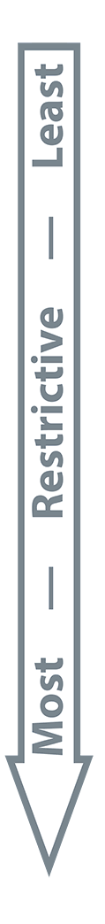
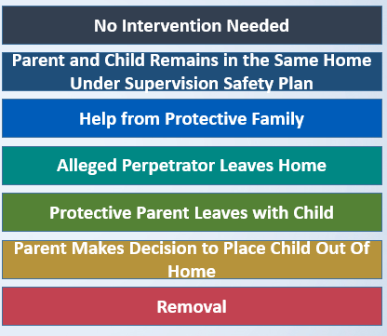
Investigations
Least Restrictive Intervention
Staff identify the least restrictive intervention that is reasonably anticipated to
keep the child safe.
The Department can also provide Family-Based Safety Services (FBSS) which are designed to maintain children safely in their homes—or make it possible for children to return home—by strengthening the ability of families to protect their children and reducing threats to their safety. These services are provided directly by Department staff, through contracted service providers, or through referrals to community-based providers.
Child Protective Investigations Overview

Slide 31
Family Based Safety Services ~ FBSS
*Services offered to families when the child is at risk of abuse/neglect, but safety plan options can effectively protect the child.
*Child may be in a parental child safety placement (PCSP) outside the parent’s home or may remain in the parent’s home, but the parents retain legal custody while working with CPS services.

Slide 32
FBSS VS Texas Family First
What is Texas Family First (TFF)
Texas Family First is a prevention program. This innovative program supports Texas families by giving them the tools to help them remain safely intact and prevent children from entering the foster care system. By providing greater access to mental health services and improved parenting skills, the Texas Family First program aims to increase the number of children who can remain at home with their families. Courts now have additional options when making decisions about placements and out-of-home care.
TFF is currently available in Regions 1, 2, 3W, 6a, 8a and 8b.
Child Protective Investigations Overview

Slide 33
FBSS VS Texas Family First
The difference between FBSS and TFF?
FBSS is a broader, non-evidence based program focused on family stabilization and resource connection within the community. FBSS is often voluntary but can also be court ordered.
TFF is an enhancement to FBSS offering specialized, evidence based in-home services for high-risk cases. Once a family agrees to TFF, services are court ordered to provide further support to the family. Average court involvement is 4-6 months.
Child Protective Investigations Overview

Slide 34
Investigations
Safety Plans
The Department will utilize a Safety Plan in the following instances:
Parent and child remains in the same home with supervision in place
Parent and child moves away from the danger to a safe environment
Parental Child Safety Placement (PCSP) in place and there’s a safety plan outlining supervision between parent and child
Child Protective Investigations Overview

Slide 35
Investigations
Family Team Meetings
Family Team Meetings (FTMs) are emergency meetings for available family members to address the immediate safety
of a child.
FTMs can occur within several hours of a need being identified.
Family Team Meetings generally are held before a child is removed from the home, but may also be held during other stages of service, such as when a family receives Family-Based Safety Services or when a child is in DFPS conservatorship.
They can also be offered to the family if it is believed the meeting will help the family come together to ensure the safety of the children, either with or without provision of services by DFPS.
Child Protective Investigations Overview
Notes:
Note that this is voluntarty and are family driven to allow the family to solve issues

Slide 36
RAPR’s and YOU
What happens when a child is in a facility in Juvenile Probation or the Texas Department of Juvenile Justice?
Due Diligence- Justice personnel must make a diligent effort to locate a parent or caregiver if they cannot locate a parent or caregiver or if a parent or caregiver refuses to take custody of a child when ready for release.
Report Early– This helps to start coordinating in order to prevent the child from being placed in foster care.
Remember…
Foster care is a last resort, so prior to DFPS taking custody of the child both DFPS and TJJD/Probation will likely have multiple meetings with front line and supervision staff.
The child does not have to go to a blood relative!

Slide 37
DFPS/CBC Visits to your Facility
Do you have to allow DFPS/CBC personnel access to your facility?
What DFPS/CBC personnel should be requesting access to your facility?
What can DFPS/CBC staff request?
Notes:
These are all the tasks we do in investigation. Pay special note to the visits to the family home-we make visits to home but the next slides will show the importance.

Slide 38
Questions?
Marshall Davidson (Investigations)
marshall.davidson@dfps.texas.gov
325-267-0389
Kimberly Pendleton(CPS)
Kimberly.Pendleton@dfps.texas.gov
806-420-4935

